Slide 1
The Relationship Between Cardiac Testing and Heart Disease
By Paul Venuto

Slide 2
Abstract
I used the Heart Disease Dataset to examine the relationship between variables such as demographics and cardiac tests and the diagnosis of heart disease, as defined by narrowing of the coronary artery. More specifically, I wanted to see if heart disease can be accurately predicted by the clinical and laboratory test data as well as demographic information. I used a combination of exploratory data analysis, data visualization, and machine learning techniques to answer the research questions. The findings indicate mild correlations between some of the variables and heart disease. Machine learning algorithms applied to the data could accurately predict heart disease in the test data from 72.1% to 83.6% of the time, which on the surface seems like a remarkable achievement given the small size of the dataset.

Slide 3
Motivation
In medicine, physicians face many challenges in making an accurate diagnosis. These include inconclusive and insufficient testing, limited patient access to medical care, and inconsistency with diagnostic protocols. For example, doctors may order different tests for a patient with the same symptoms, and therefore reach different diagnoses. An accurate diagnosis is critical to patient care, and may be a matter of life death.
This is personal to me as I am a physical therapist (PT), and while I don’t make diagnoses in the traditional sense, I must make an accurate assessment of my patient’s condition based on their signs and symptoms. Typically patients come to me with little diagnostic work up from their physicians, so my initial evaluation and assessment guides me in selecting optimal treatments to improve their physical condition.
My interest is in learning how data science and machine learning can be used to make more accurate medical diagnoses.

Slide 4
Dataset
The dataset I used for my project is the Heart Disease Dataset, which was created by Cardiologists and Researchers from Hungary, Switzerland, and the United States. Specifically, I will examine a subset of 14 of the attributes which includes demographic information as well as cardiac function test results. It includes 303 samples of test results and demographic data for cardiac patients. I found the dataset on both the UCI Machine Learning Repository and Kaggle websites.

Slide 5
Data Preparation and Cleaning
First, I checked for NA and null values, of which there were none, and then I checked for duplicates. There was one duplicate so it was removed.
To apply machine learning algorithms, the data was normalized and categorical variables had to be converted into indicator (dummy) variables. The resulting dataset had only 0 or 1 values for these variables, which is required for machine learning applications

Slide 6
Research Questions
1. What is the relationship between cardiac function test results and heart disease?
2. Can heart disease by accurately predicted by such test results?

Slide 7
Methods
A variety of data science methods were used in the analysis of this dataset, including exploratory data analysis, data visualization, correlation, machine learning algorithms, and confusion matrixes.

Slide 8
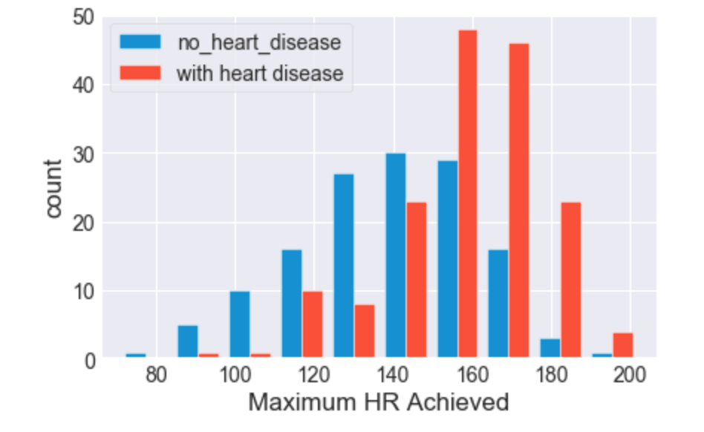
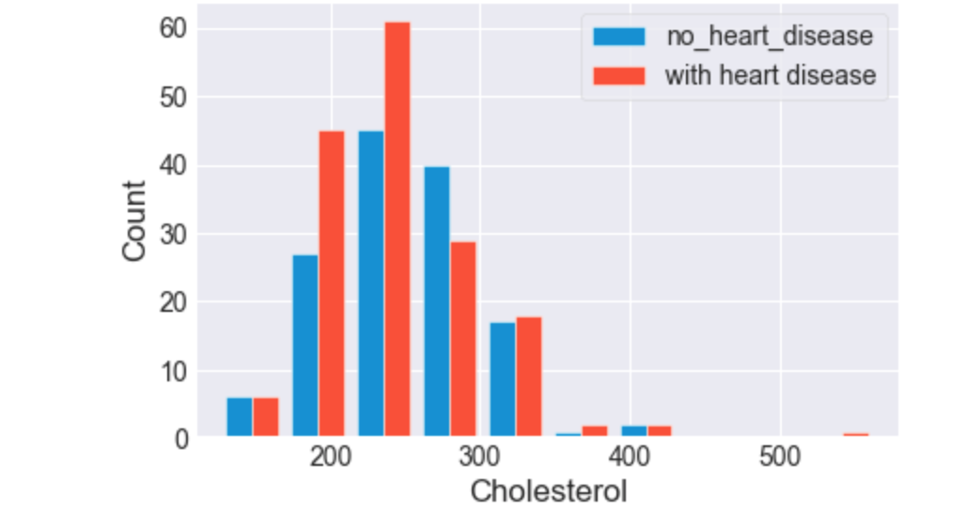
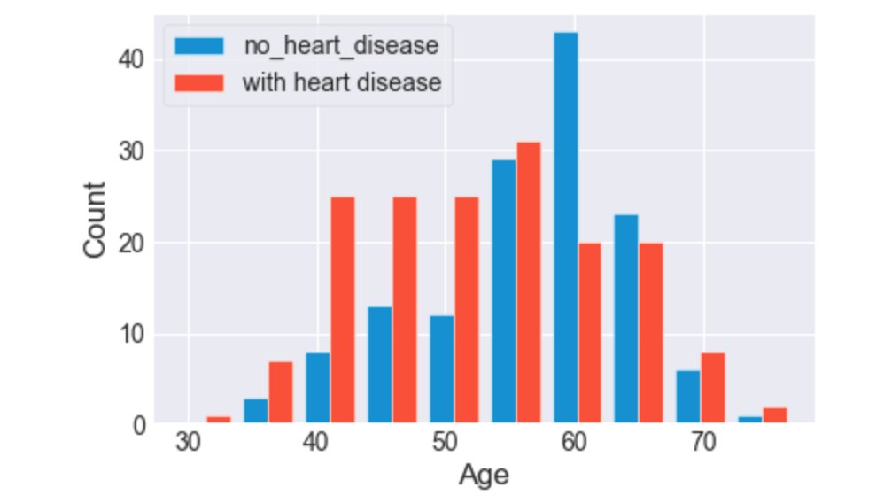
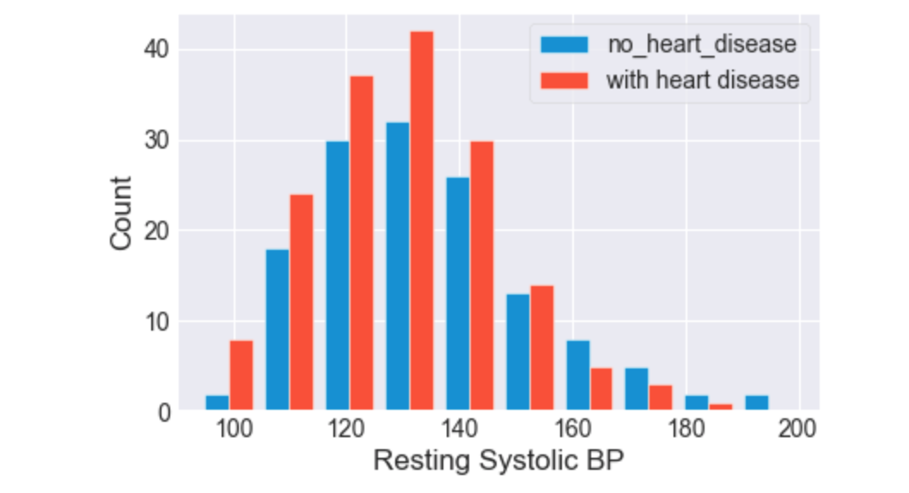
Findings: which variables were associated with heart disease?
The number of samples with heart disease was similar among subjects aged 40s-60s.
For systolic blood pressure and cholesterol, the number of samples with heart disease was highest in the middle range (130s and mid 200s respectively).
For maximum HR achieved (on a stress test), the highest counts of heart disease were those in the 150s and 160s

Slide 9
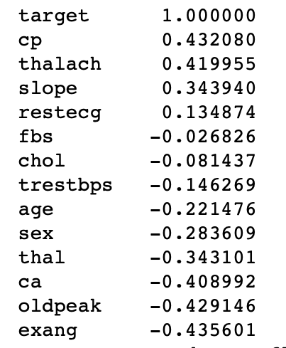
Findings: Correlation
No strong correlations between individual variables and heart disease were found.
The strongest positive correlation was chest pain (0.43) and the strongest negative correlation was exercise-induced angina (-0.44). This is an interesting finding because intuitively one would think that exercised-induced angina would be an indicator of heart disease

Slide 10
Findings: Machine Learning
The data were split into a training and test set, and five supervised classification algorithms were applied to the test data. They were able to predict heart disease ranging from 72.1% to 83.6% of the time, depending upon the algorithm.
Algorithm | Accuracy Score
Logistic Regression | 72.1%
Support Vector Machine | 75.4%
Decision Tree | 83.6%
Naïve Bayes | 80.3%
Random Forest | 83.6%

Slide 11
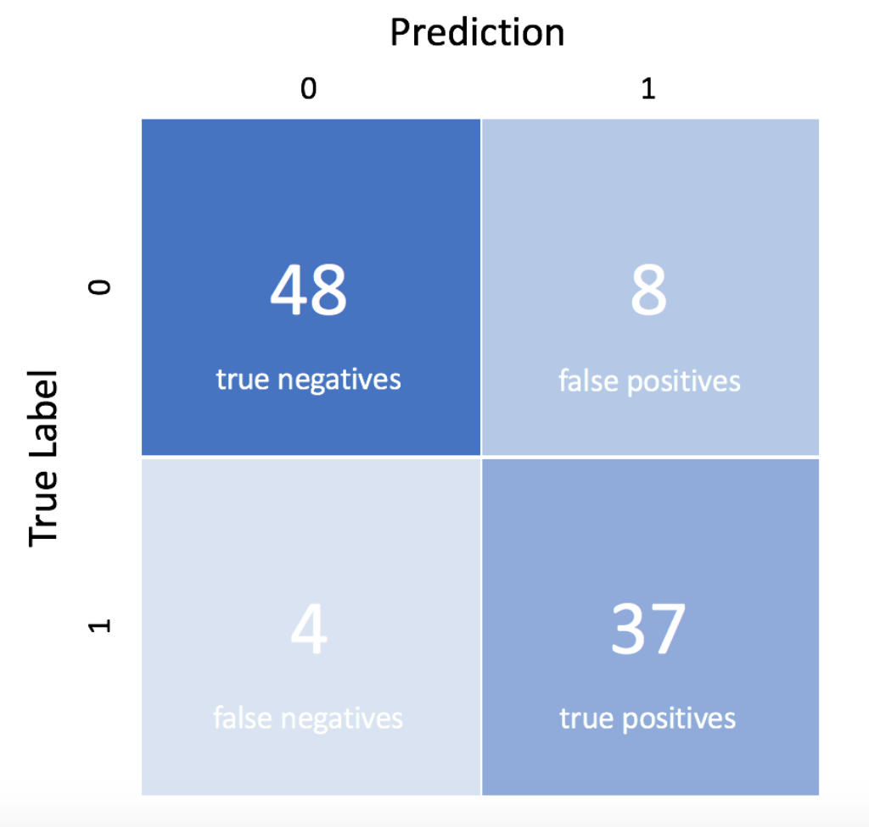
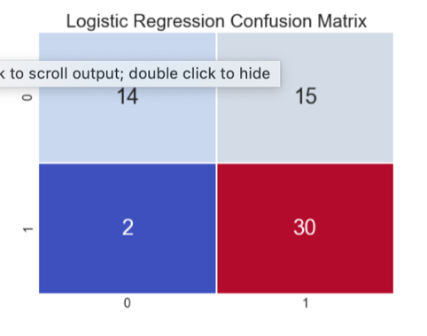
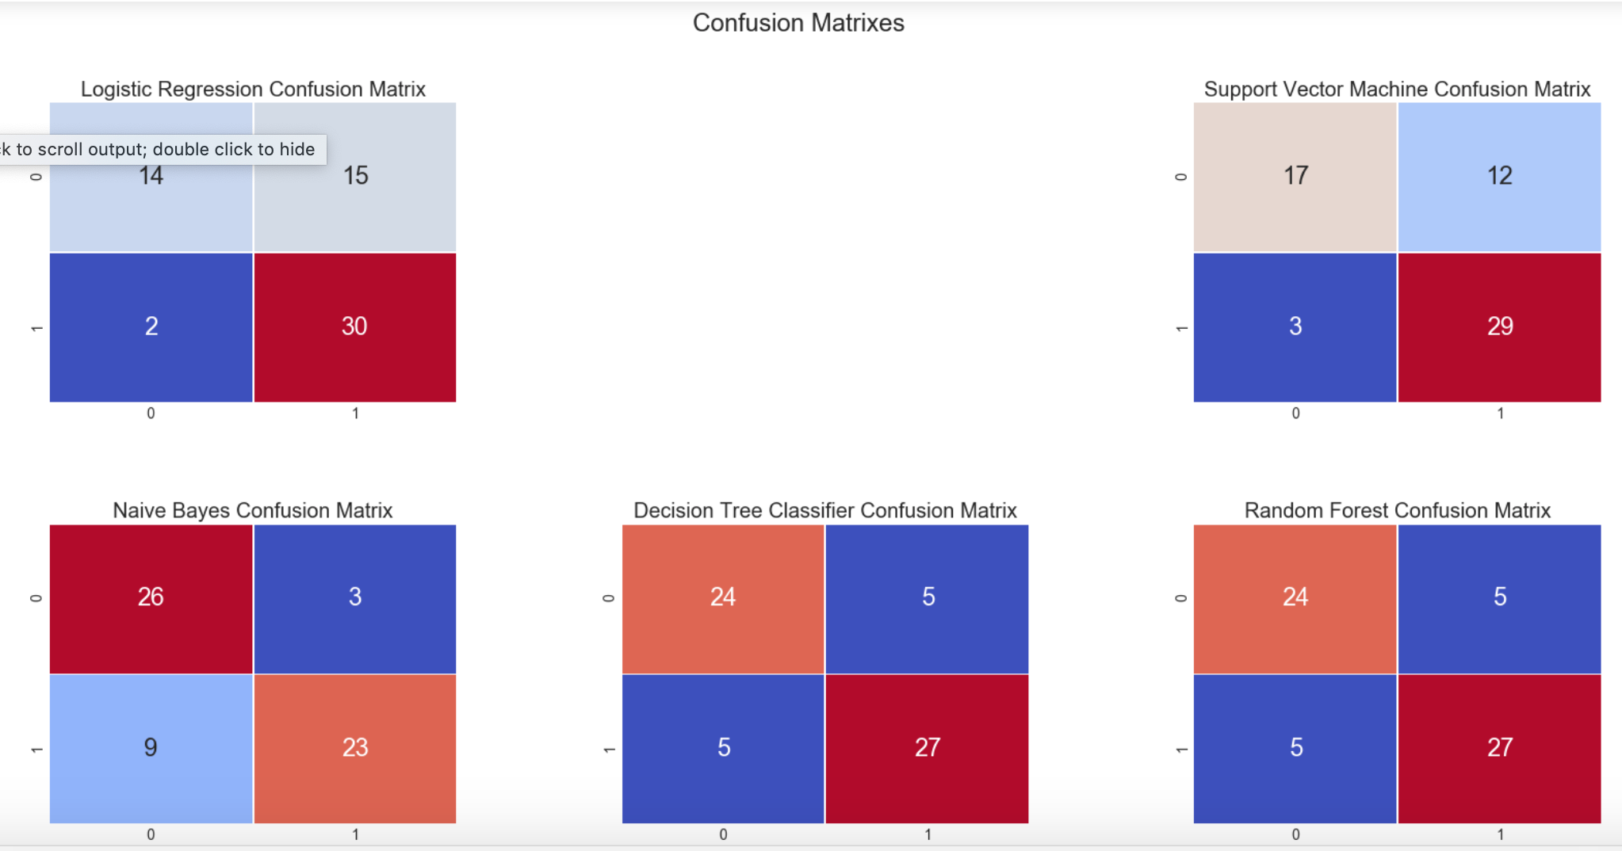
Findings: Confusion Matrixes
Key:

Slide 12
Findings: Confusion Matrixes
The confusion matrixes reveal that there are too many false positives and true negatives in the modeling for this to be considered valuable models. False negatives are particularly dangerous, as they incorrectly diagnose someone as not having heart disease, when in fact they do have heart disease.

Slide 13
Limitations
The dataset is small (only 303 samples), and nothing is known about the demographics of the patients except age and gender. This might explain the many false negatives and false positives in the confusion matrixes.
There are other techniques that could be applied, such as cross-validation, that may improve the machine learning modeling.
Also, the target variable was categorized based on coronary artery occlusion. But this is only one type of heart disease, and other types were not considered. It would also be interesting to know the exact amount the coronary artery was occluded. Then it could be turned into a regression problem, where the amount of heart disease is predicted.

Slide 14
Conclusions
The dataset has revealed some interesting associations among cardiac test results and heart disease. In particular, long held beliefs about clinical tests such as blood pressure, lab values such as cholesterol, and cardiac stress tests may need to be reconsidered.
While there are some interesting findings from the data, more data is needed to better understand the relationship between cardiac function test results and heart disease.
Based on the results of machine learning modeling, insightful inferences cannot be made from this one dataset. That would require a much richer dataset with more samples, that include people of all ethnic, racial, and geographical backgrounds. Perhaps additional cardiac function tests need to be considered as well.

Slide 15
Acknowledgements
The dataset is from Kaggle (https://www.kaggle.com/ronitf/heart-disease-uci) and originally published by the UC Irvine machine learning repository website (https://archive.ics.uci.edu/ml/datasets/Heart+Disease).
While no one gave me feedback on this project, I referenced several other Kaggle workbooks and websites:
https://www.kaggle.com/digvijayyadav/beginners-guide-to-simple-machine-learning
https://www.kaggle.com/purvitsharma/heart-disease-classification
https://www.jeremyjordan.me/evaluating-a-machine-learning-model/

Slide 16
References
VanderPlas, J. (n.d.). Python Data Science Handbook. Retrieved March 19, 2021, from https://jakevdp.github.io/PythonDataScienceHandbook/

